Slide 1

BILLIONAIRE MINDSET
The "billionaire mindset" generally refers to a specific set of attitudes, beliefs, and habits that are believed to be conducive to accumulating wealth and achieving financial success. It involves a focus on long-term goals, calculated risk-taking, and a willingness to learn from mistakes. Key aspects include a strong work ethic, resilience in the face of setbacks, and the ability to identify and capitalize on opportunities.

Slide 2

INTRODUCTION
What sets billionaires apart?
Is it luck, hard work, or mindset?
Let's dive into the psychological patterns, habits, and beliefs that shape the billionaire mindset.

Slide 3

CORE BELIEF SYSTEM
Think in terms of abundance, not scarcity.
Problems = Opportunities.
Failure is feedback, not defeat.
Long-term vision over short-term gains.

Slide 4
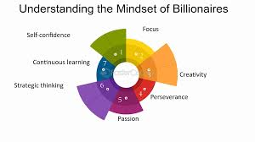
VISION AND PURPOSE
Clear goals backed by a strong purpose.
Billionaires think 10x bigger than others.
They solve global problems, not just personal ones.
"If your goals don't scare you, they aren't big enough."

Slide 5
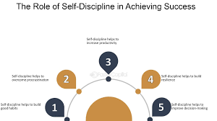
MASSIVE ACTION+DISCIPLINE
Relentless execution.
Daily routines built on consistency.
Prioritize action over perfection.

Slide 6
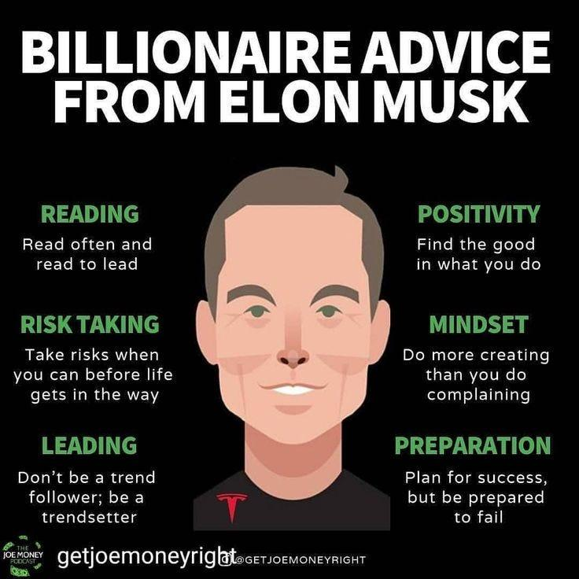
RISK TAKING & RESILIENCE
Calculated risk is essential.
Failure is embraced, not feared.
Resilience turns setbacks into comebacks.

Slide 7
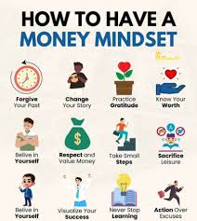
CONTINUOUS LEARNING
Read every day — Warren Buffett, Elon Musk, Bill Gates.
Learn from mentors, books, and experience.
Adapt to change quickly.

Slide 8
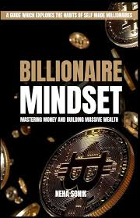
WEALTH IS TOOL, NOT A GOAL
Billionaires think in value creation, not money hoarding.
Wealth is a byproduct of solving problems at scale.

Slide 9
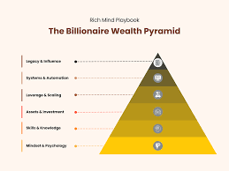
LEVERAGE: PEOPLE, SYSTEMS, CAPITAL
Leverage other people's time (teams).
Build systems to scale.
Use capital smartly — investing, not spending.

Slide 10
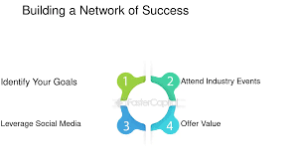
NETWORKING & RELATIONSHIPS
Build high-value networks.
Collaborate with people smarter than you.
Reputation is currency.

Slide 11
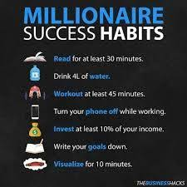
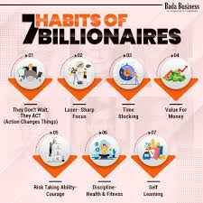
BILLIONAIRE HABITS
Wake up early.
Plan the day.
Focus on health.
Meditate, reflect, and improve daily.

Slide 12
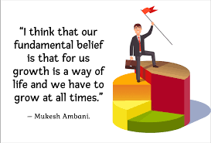
FAMOUS BILLIONAIRE MINDSET
Elon Musk: Solve hard problems, no excuses.
Jeff Bezos: Customer obsession.
Oprah Winfrey: Gratitude and giving back.
Warren Buffett: Long-term thinking.

Slide 13

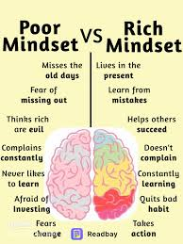
KEY TAKEAWAYS
Mindset > Skillset.
Think Big, Start Small, Act Now.
Be obsessed with growth.
Invest in yourself.

